Slide 1
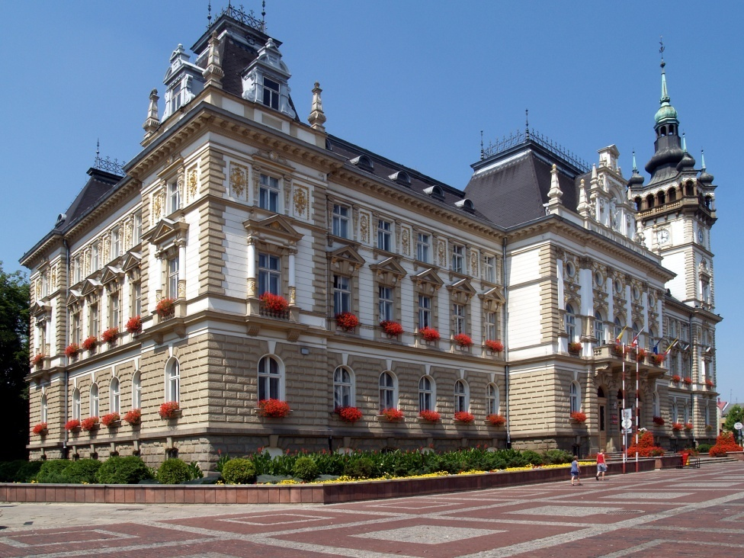
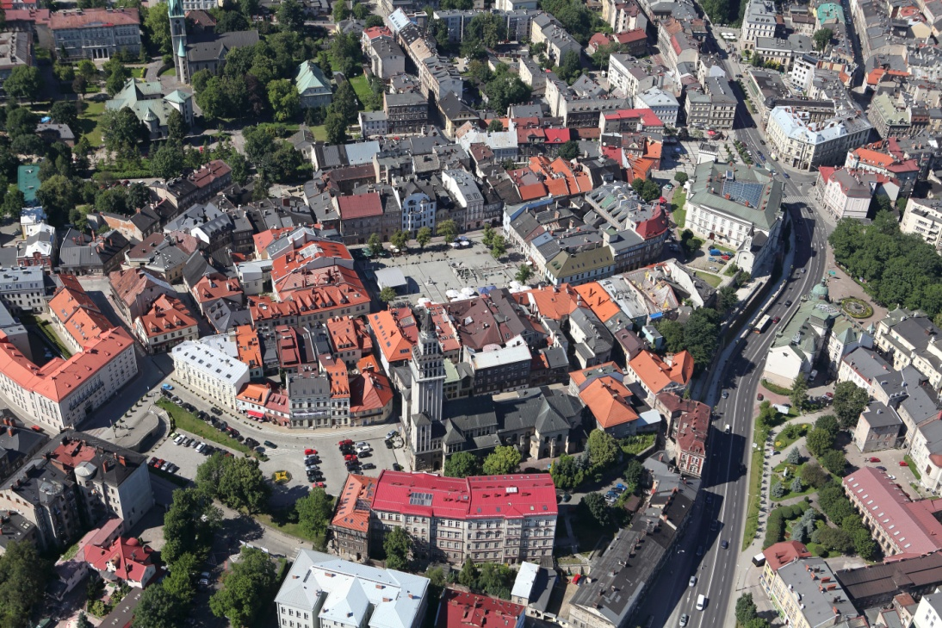
Bielsko-Biała
City of entrepreneurship
Strategy and Economic Development Department
City Hall of Bielsko-Biała
August, 2019

Slide 2
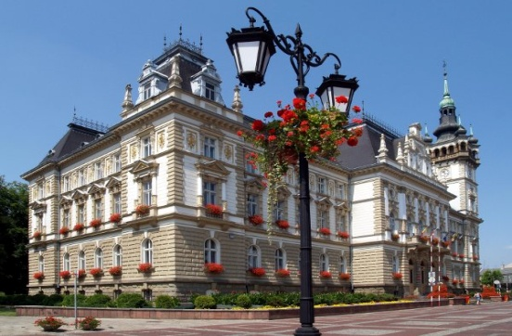
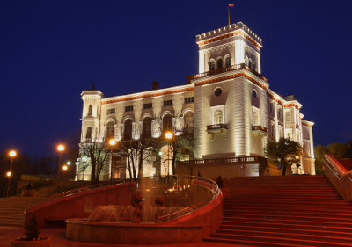
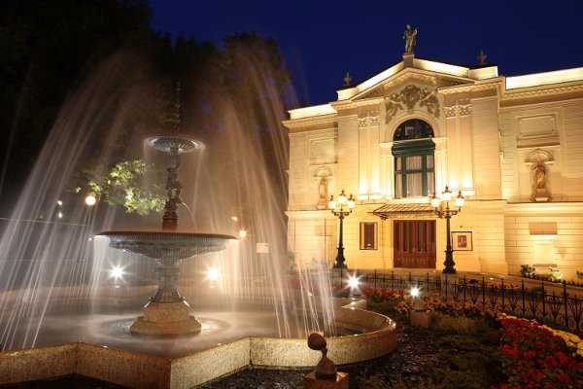
Bielsko-Biała
Bielsko-Biała has a population of 171 thousands inhabitants and is situated in the southern part of the Silesian region. It is also a capital City of the southern subregion of Silesian Voivodeship.
Bielsko-Biała is a dynamic centre of economy. It used to be called „the City of 100 industries” as well as „Manchester of Silesia”.
Close proximity to the Upper Silesian conurbation and Kraków, as well as to the Czech Ostrava and Slovakian Žilina, makes Bielsko-Biała an important centre of development cross-border in nature.

Slide 3
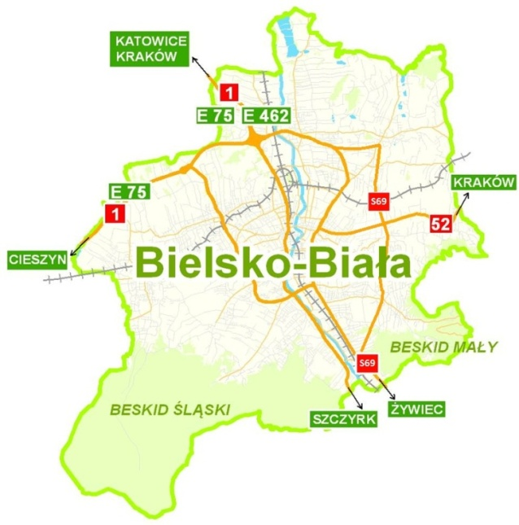
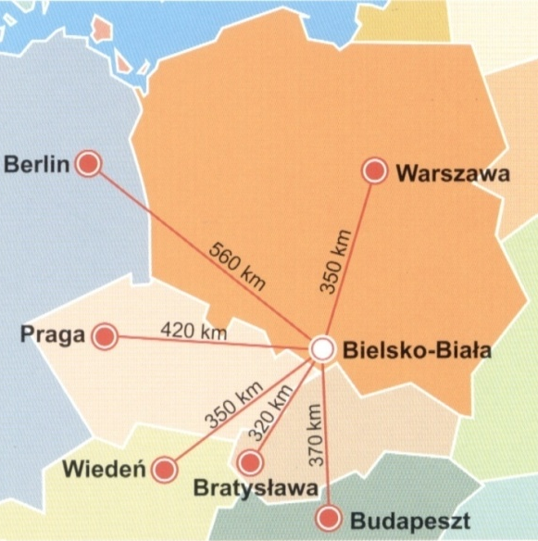
Bielsko-Biała – convenient location
The dynamic development of the city is facilitated by the crossing of the international transport channels E75 and E462. The city is also an important road junction in the south Silesia. Bielsko-Biała is crossed by: national road No. 1 (as an expressway S52 from Bielsko-Biała to Cieszyn), express road S1, national road S52, as well as voivodeship roads No. 940 and 942.
The nearest airports: Katowice-Pyrzowice (85 km), Kraków-Balice (110 km), Ostrava-Mošnov (CZ) (65 km).

Slide 4
Bielsko-Biała – statistic data
Area: 125 km² (12 451 ha)
Population: 171 259 inhabitants
Population per 1 km²: 1375 people/km²
Natural increase of the population (per 1000 inhabitants): : -0,6
Source: Statistic Poland, 2019.

Slide 5
Bielsko-Biała – workers over the years

Slide 6
Bielsko-Biała – workers currently
Employed persons (in total): 82 455
Sections G, H, I, J - “Wholesale and retail trade, repair of motor vehicles and motorcycles”, “Transportation and storage”, “Accommodation and food service activities”, “Information and communication”.
Sections K, L - “Financial and insurance activities”, “Real estate activities”.
Other services - “Professional, scientific and technical activities”, “Administrative and support service activities”, “Public administration and defence; compulsory social security”, “Education”, “Human health and social work activities”, “Arts, entertainment and recreation” and “Other service activities”.
Source: Statistics Poland, 2019.

Slide 7
Bielsko-Biała – labour market
Unemployment rate
in Bielsko-Biała (30th June 2019): 1,8%
In comparison
average unemployment :
In County of Bielsko: 3,1%
In Silesian Voivodeship: 3,9%
In Poland: 5,3%
Source: Statistics Poland, 2019.

Slide 8
Bielsko-Biała - unemployment
Source: County Labour Office in Bielsko-Biała, 2019 .

Slide 9
Bielsko-Biała – economic activity
National economy entities
(as at: 31.12.2018)
The scale of entrepreneurship of Bielsko – Biała confirms the high rate of entities of the national economy per 1000 population.
Source: Statistical Office in Katowice, 2019
.

Slide 10
Bielsko-Biała – economic activity
Bielsko-Biała: average monthly gross wages and salaries in 2017 (total): : 4 446,37 PLN ie. 98,2% of average monthly gross wages in relation to the national average (Poland=100)
Source: Statistical Office in Katowice, 2019
.

Slide 11
Bielsko-Biała – economic activity
Bielsko-Biała – economic entities by number of paid employees (as at: 31.12.2018 )
number of paid employees in the enterprises | number of enterprises
0-9 | 24 784
10-49 | 989
50-249 | 224
250-999 | 40
over 1000 | 4
Total | 26 041
Bielsko-Biała – economic entities by ownership sectors (as at: 31.12.2018 )
ownership sector | number of enterprises
Private sector including: | 25 108
sole proprietorship commercial companies commercial companies with foreign capital participation | 18 042 3 402 532
Public sector | 570
Total | 26 041
Source: Statistical Office in Katowice, 2019
.

Slide 12
Bielsko-Biała – economic activity
Selected data concerning local economy in a comparative background
Specification | Industry sold production (as at: 31.12.2018) |  | Investment outlays in enterprises (as at: 31.12.2017) | Gross value of fixed assets in enterprises (as at: 31.12.2017)
 | thous. PLN | Per 1 inhabitant in PLN | thous. PLN | thous. PLN
Bielsko-Biała | 26 711,7 | 155 456 | 1 942,4 | 17 811,4
Częstochowa | 9 891,3 | 43 900 | 967,6 | 11 146,8
Gliwice | 20 152,0 | 110 899 | 1 150,5 | 22 211,0
Katowice | 18 236,7 | 61 362 | 2 391,4 | 32 004,4
Rybnik | 3 303,0 | 23 750 | 555,7 | 10 654,4
Silesian Voivodeship | 221 533,3 | 48 661 | 20 368 | 256 635,2
Source: Statistics Poland, 2019.

Slide 13
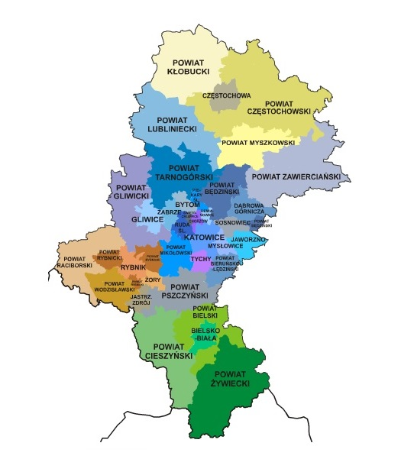
EU Funds (2007-2013) –
acquired by the business sector
Map of co-financing – Regional Programme of Silesian Voivodeship 2007-2013 Priorities I and III - Measures for the micro and SME
(according to the beneficiary's location, as at: 31.03.2018.)
Częstochowa: 50,45 mln PLN
Zabrze: 41,38 mln PLN
Gliwice: 72,06 mln PLN
Micro, small and medium entrepreneurs from Bielsko-Biała implemented with the support of EU funds for the Silesian Voivodeship 2007-2013: 264 projects co-financed with the total amount of: 85 122 908,32 PLN.
This is the second highest result of the enterprise sector in Silesia.
Dąbrowa G.: 17,94 mln PLN
Sosnowiec: 28,16 mln PLN
Katowice: 85,72 mln PLN
Tychy: 25,61 mln PLN
Rybnik: 31,85 mln PLN
Bielsko-Biała: 85,12 mln PLN
Source: Silesian Centre for Entrepreneurship, 2018.

Slide 14
EU funds (2007-2013) Operational Programme Innovative Economy
Co-financing map –
Operational Programme Innovative Economy
2007-2013
(as at: 31.03.2018)
Częstochowa: 151 mln PLN
Zabrze: 148 mln PLN
With the support of EU funds for 2007-2013 in the field of innovation, R&D, modern technologies - entities from Bielsko-Biała implemented 146 projects co-financed with the total amount: 315 492 230,66 PLN, and their total value: 1 606 027 872,14 PLN.
This is the third highest result in Silesia after Katowice (381 mln PLN) and Gliwice (320 mln PLN).
Gliwice: 320 mln PLN
Dąbrowa G.: 134 mln PLN
Sosnowiec: 78 mln PLN
Katowice: 381 mln PLN
Tychy: 88 mln PLN
Rybnik: 26 mln PLN
Bielsko-Biała: 315 mln PLN
Source: Krajowy System Informatyczny SIMIK 2007-2013, 31.03.2018.

Slide 15
Katowice Special Economic Zone (KSEZ)
In 1999 local authorities made the decision to include selected areas in the city into the KSEZ area.
The Katowice Special Economic Zone in Bielsko–Biała was founded in order to support restructuring processes and to create new jobs in the region.
The investors in the Jastrzębie -Żory Subzone of KSEZ in Bielsko-Biała
entity | industry sector
Electropoli-Galwanotechnika Sp. z o.o. | automotive
AVIO Polska Sp. z o.o. | aviation
Cornaglia Polska Sp. z o.o. | automotive
Eaton Automotive Systems Sp. z o.o. | automotive
FCA Services Polska Sp. z o.o. | accounting services
Magneti Marelli Suspension Systems Bielsko Sp. z o.o. | automotive
Henkel Polska Sp. z o.o. | metal
Cooper Standard Polska Sp. z o.o. | automotive
Takoni Sp. z o.o. | plastics
MDM NT Sp. z o.o. | construction
Polmotors Sp. z o.o. | metal
Pojazdy Specjalistyczne Zbigniew Szczęśniak Sp. z o.o. | automotive
TRW Steering Systems Poland Sp. z o.o. | automotive
TI Poland Sp. z o.o. | automotive
At present 14 enterprises have got the permission to act in the Jastrzębie – Żory Subzone of KSEZ in Bielsko-Biała. They employ over 4 thousand people. The KSEZ in Bielsko –Biała is divided into 4 areas and covers 48 ha in total.
The total amount of investments ≈ 1,7 billion PLN.
Source: Katowice Special Economic Zone, 2019

Slide 16
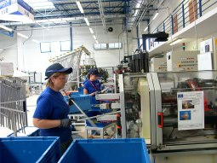
Industrial and Technology Park, Beskid Technology Incubator
An Industrial and Technology Park and Beskid Technology Incubator are located in the neighbourhood of KSEZ in Wapienica district.
The idea behind the establishment of these two entities is to create optimal conditions for development of small and medium-sized companies, especially from the innovation sector.
Industrial and Technology Park (I&T Park)
Industrial and Technology Park was created as a part of a project „Business infrastructure in Silesia – Bielsko-Biała – Industrial and Service Park ”.
The idea of establishment of I&T Park is to create a multifunctional economic activity area by the collaboration with science and research institutions and units providing services for small and medium-sized companies.
The I&T Park covers the area of 5,12 ha and the following companies have their seats:
> Hutchinson Poland Sp. z o.o. –world market leader in rubber products for
the automotive sector,
> Ti Poland Sp. z o.o. – company from the automotive sector,
> Multiform Dariusz Krywult – company from the automotive and construction
sector
> Beskid Technology Incubator

Slide 17
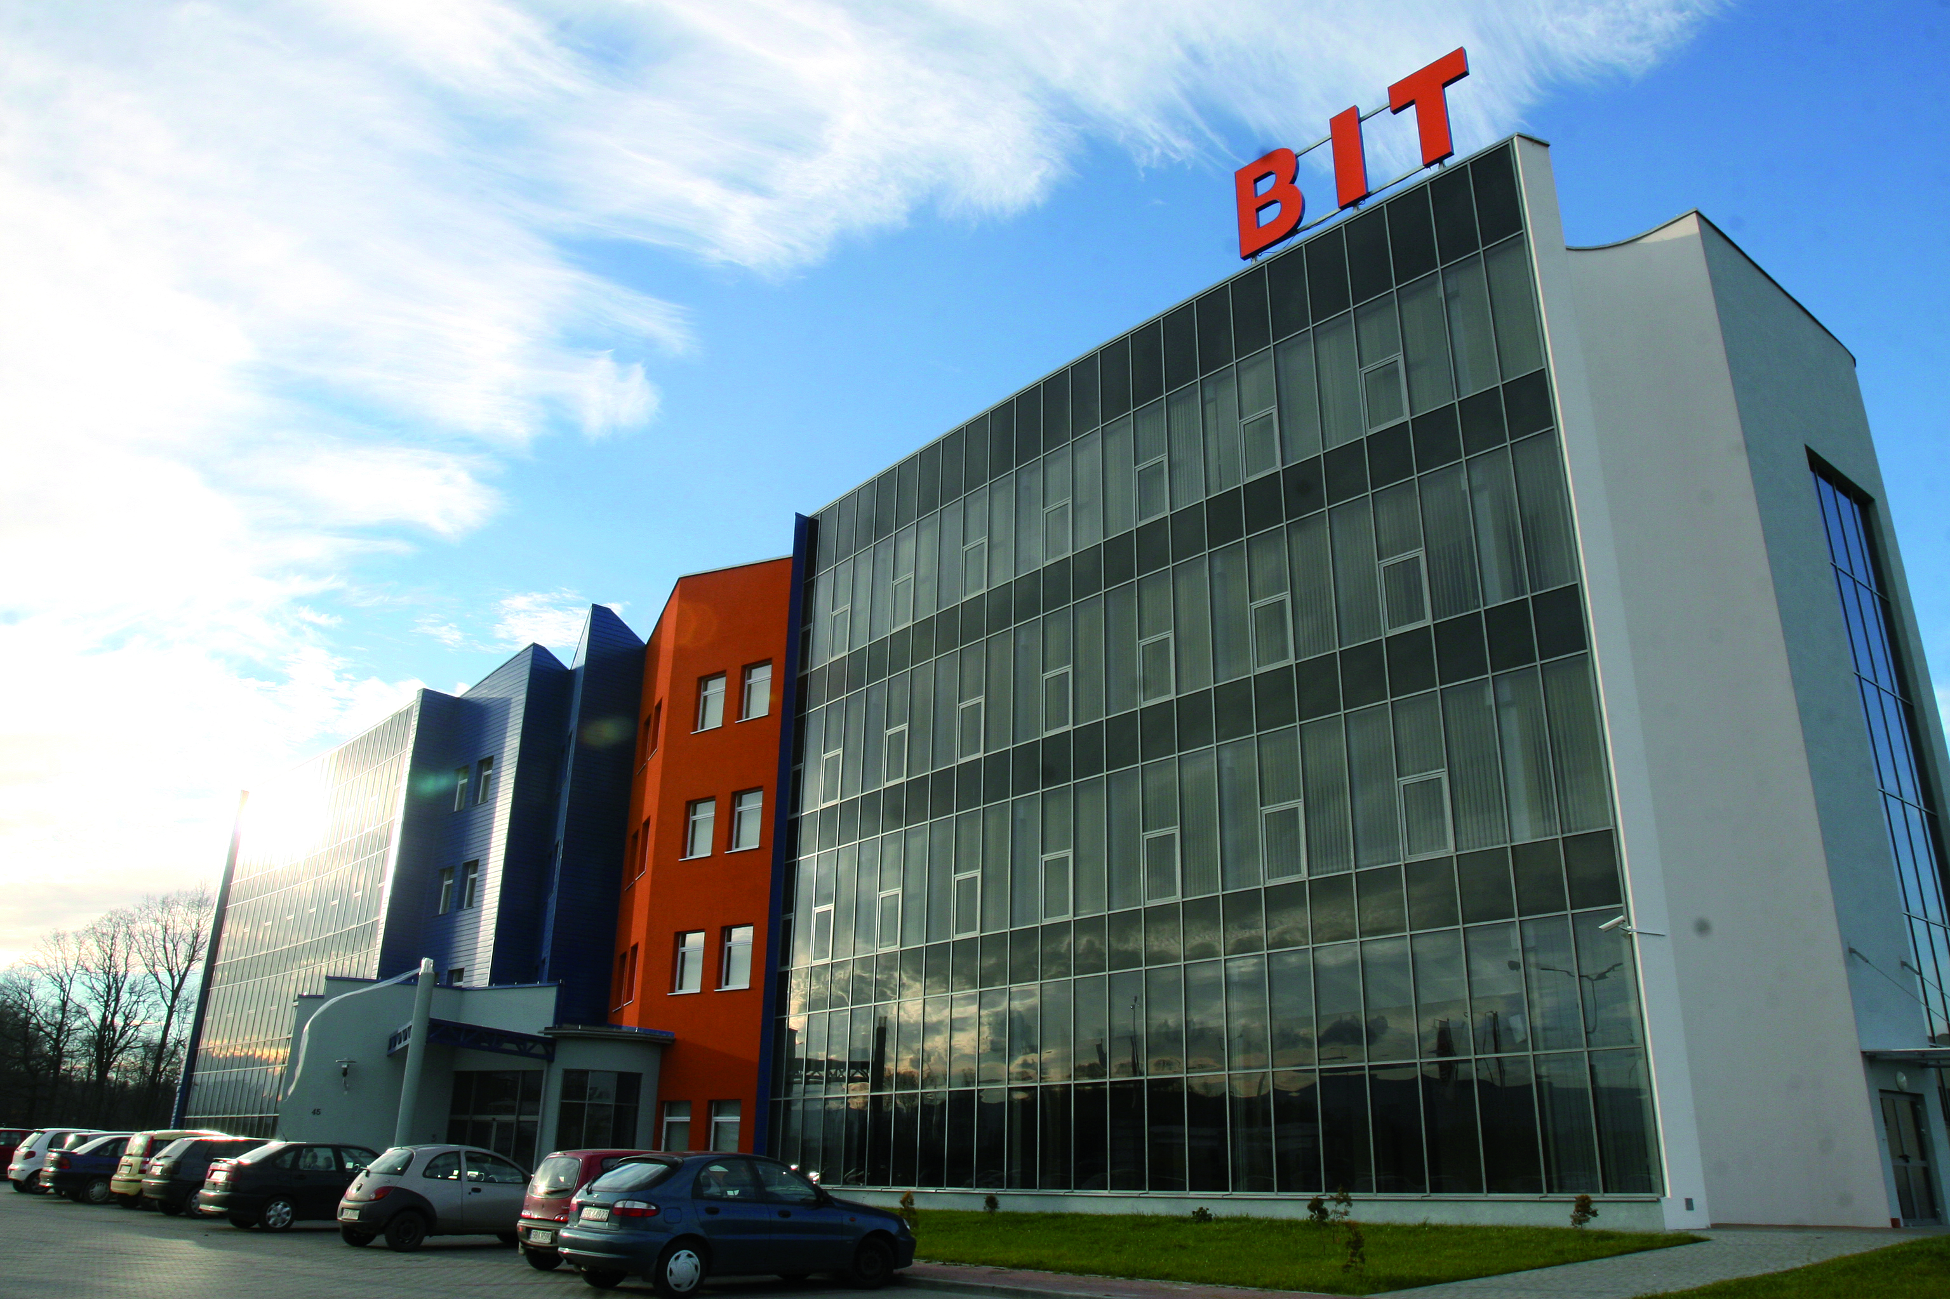
Industrial and Technology Park, Beskid Technology Incubator
Beskid Technology Incubator (BTI)
BTI is situated in the Industrial and Technology Park and was created thanks to the cooperation of: Regional Development Agency, City Hall of Bielsko-Biała and The University of Bielsko-Biała.
The Beskid Technology Incubator aims to:
promote the setting up of new technology-based companies,
create optimal conditions for the transfer of technology and knowledge from academic centres to companies,
provide business consulting and promote companies located in the Incubator.
The Technology Transfer Center (as a part of BTI) aims to create the terms of synergy between the worlds of science and business.

Slide 18
Bielsko-Biała – industrial investments
Due to the excellent location, good economic climate and investment policy in the city, many foreign companies decided to invest in Bielsko-Biała
The most important of them are:
FCA Poland S.A.
FCA Powertrain Poland Sp. z o.o.
Nemak Poland Sp. z o.o.
Eaton Automotive Systems Sp. z o.o.
Bulten Polska S.A.
Adler Polska Sp. z o.o.
Cooper-Standard Polska Sp. z o.o.
GE Power Controls Sp. z o.o.
Electropoli-Galwanotechnika Sp. z o.o.
Avio Polska Sp. z o.o.
Hutchinson Poland Sp. z o.o.
Philips Lighting Bielsko Sp. z o.o.
TRW Steering Systems Poland Sp. z o.o.

Slide 19
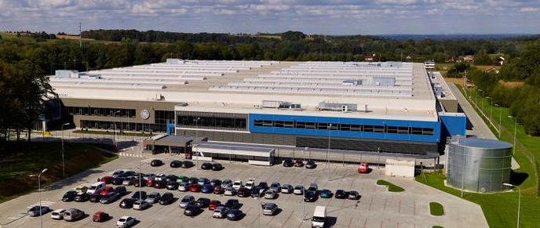
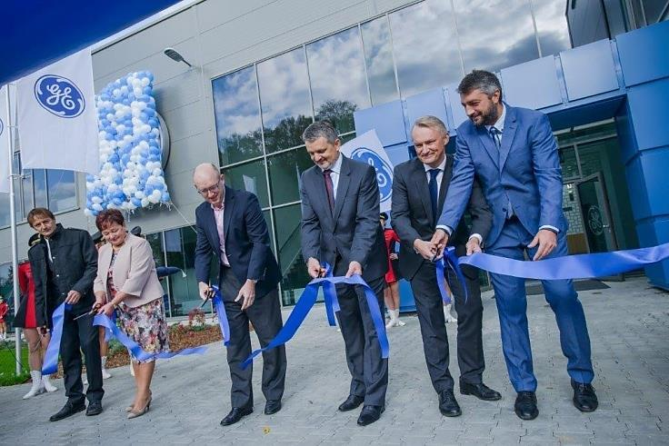
Bielsko-Biała – research and development
GE – Brilliant Factory and Customer Experience Center in Bielsko-Biała.
W In 2014 General Electric (GE) has started the construction of Brilliant Factory in Bielsko-Biala (45 000 sq.m, U.S. $ 54 million, approx 1200 employees).
GE operates in the local market for 14 years.
The new facility include:
Low-and Medium-Voltage IEC Product Certification Lab for sharing prototypes and design concepts with customers;
Product Accelerator Lab for rapid prototyping and technology development embracing FastWorks methodologies;
Customer and Employee Training Center for continuous learning opportunities, including new product introductions and processes.
„(…) this will be the most advanced manufacturing facility that GE’s has around the world, with the most technologically advanced equipment” - said Mark W. Begor, President and CEO of GE Energy Management.
The grand opening of the new GE’s factory took place on October 24, 2015.

Slide 20
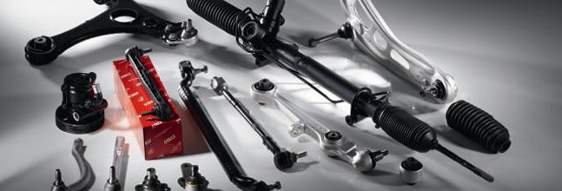
Bielsko-Biała – research and development
Technical Center of Steering Systems of ZF TRW
November 24, 2015 – ZF TRW has opened a new Technical Center of Steering Systems in Bielsko-Biała.
ZF TRW is a leading manufacturer and distributor of active and passive safety systems, supporting all major vehicle manufacturers around the world.
New Engineering Centre in Bielsko-Biała (3 600 sq.m) is the company’s ninth Technical Centre aimed at the development of electrically powered steering systems.
The new centre will be responsible for software designing, testing and validation processes for EPS .

Slide 21
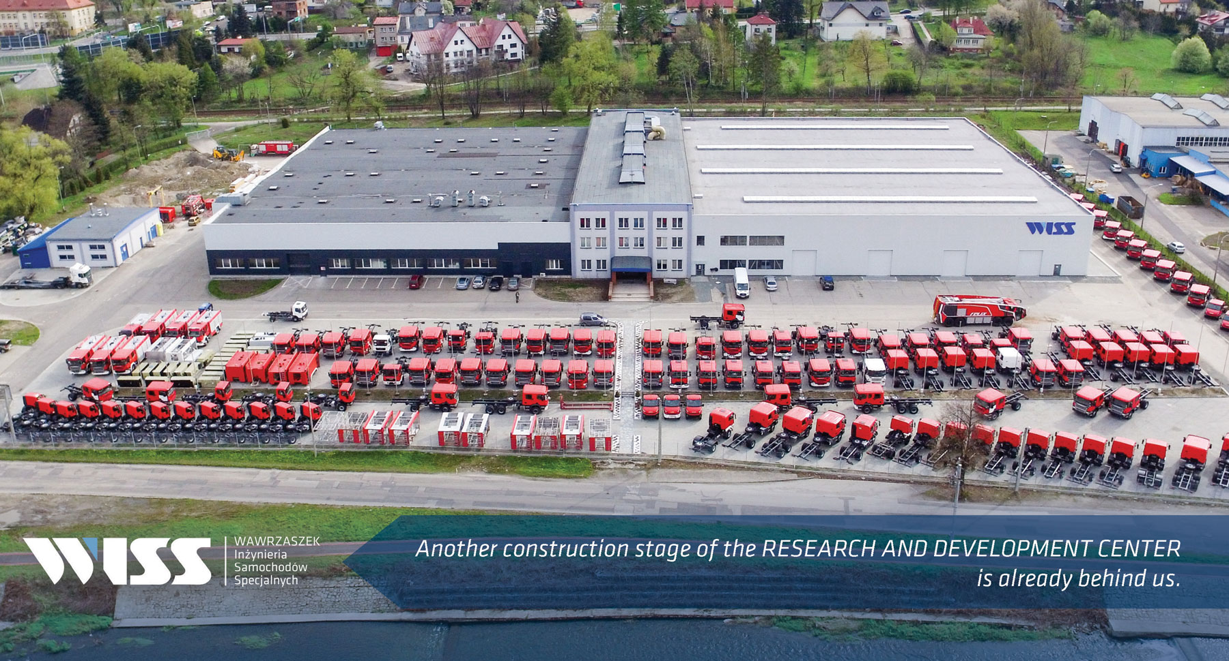
Bielsko-Biała – research and development
In 2016, the foundation stone was laid for the construction of a new research and development center of the Bielsko-Biała’s Wawrzaszek Special Vehicles Engineering Company. The investment consists of a building, an adjacent infrastructure and a research field. The new Center will be outfitted with specialized laboratory equipment. Together with its technical facilities, will be the WISS’s research base and a place of cooperation with scientific research institutes and other institutions. The opening of the Center was announced in 2019.

Slide 22
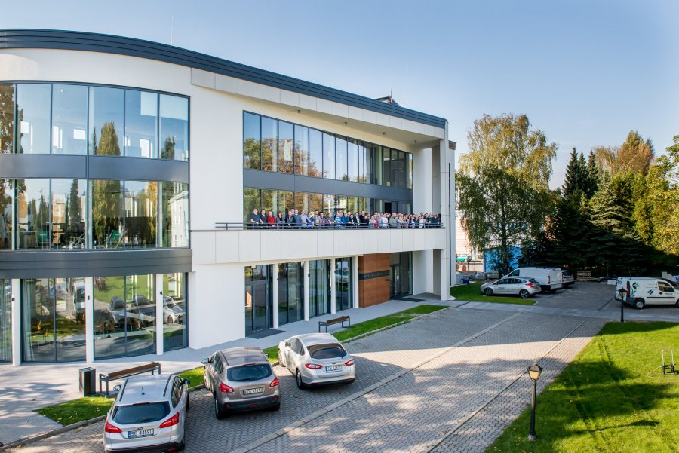
Bielsko-Biała – research and development
Not only automotive companies invest in innovation in Bielsko-Biała. At the end of 2017, the construction of its own Research and Development Centre was completed by the IT company REKORD SI. The Centre consists of nine IT laboratories, a modern server room, technical facilities and laboratories for knowledge transfer. The new facility will allow about 50 IT specialists to work in comfortable conditions.

Slide 23
Bielsko-Biała – City budget for 2019 (forecast)
Revenues
1 242 228 094 PLN
Expenditure
1 340 514 618 zł
PIT and CIT
347 760 436 PLN
General subvention
246 505 023 PLN
Taxes or charges
228 929 821 PLN
Education and educational care
425 671 101 PLN
Transport and communication
289 175 926 PLN
Health and social care
289 214 152 PLN
Source: Budget resolution of the City of Bielsko-Biała 2019.

Slide 24
Bielsko-Biała – pro-investment policy
Expenditures for investments in the years
2000-2018
Expenditures for investments 2000-2018
Percentage of expenditures for investments
(in the total expenses) 2000-2018
Source: Report on the implementation of the City budget in the years: 2000 - 2018

Slide 25
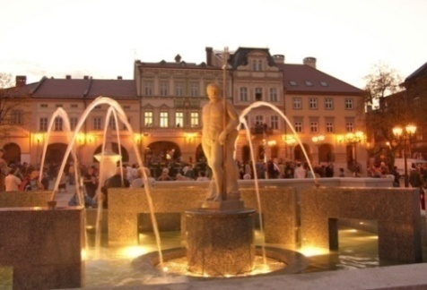
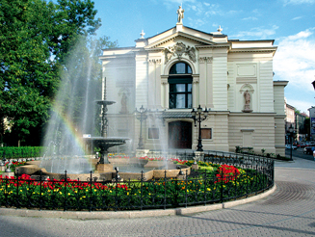
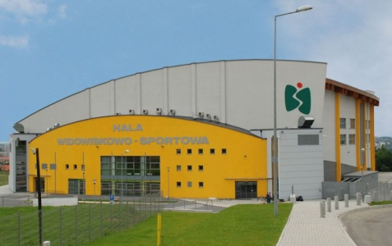
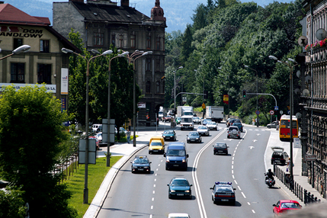
The most important municipal investments
Construction of the West Bypass of Bielsko-Biała:
Klubowa Street , City Centre Ring Road Hulanka, General W. Anders Avenue
(value of the investment: 158 mln PLN)
The revitalization of buildings in the Bielsko Old Town
(value of the investment: 11,5 mln PLN)
Modernization and renewal of the main building of Polish Theatre and Small Stage in Bielsko-Biała (value of the investment: 11,3 mln PLN)
Construction of the sewage system in the district Lipnik and Hałcnów of Bielsko-Biała (implementation: AQUA S.A., value of the investment: 38,5 mln PLN)
Construction of the multifunctional hall (sport, entertainment and exhibition) in Bielsko-Biała
(value of the investment: 77,2 mln PLN)
Improvement of the road connections – Modernization of the voivodeship route No. 942 in Bielsko-Biała (value of the investment: 19,5 mln PLN)

Slide 26
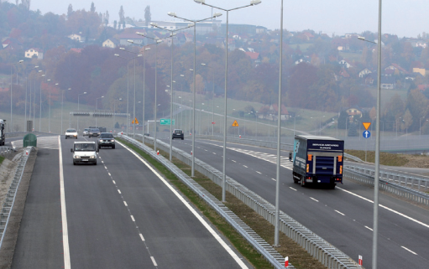
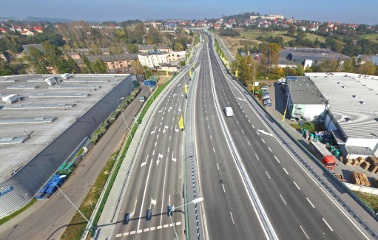
The most important municipal investments
Construction of the North-East Bypass of Bielsko-Biała – within the frame of construction of the expressway S69 Bielsko-Biała - Żywiec (implementation: GDDKiA, value of the investment: 1,5 mld PLN)
Reconstruction of the domestic road No. 52
Wyzwolenia St./Niepodległości St.
(value of the investment: 122 mln PLN)
Connection of the roads No. 942 and No. 69 in Bielsko-Biała. Construction of a bridge over the river Biała.
(value of the investment: 21,5 mln PLN)
Construction of the complex waste management system for Bielsko-Biała and communities of Powiat Bielski implementation : Zakład Gospodarki Odpadami S.A., value of the investment: 87 mln PLN)
Modernization of the outdoor swimming pool „START” and arrangement of Dębowiec slope into the all-year-round tourist and recreation infrastructure
(value of the investment: 61,3 mln PLN)

Slide 27
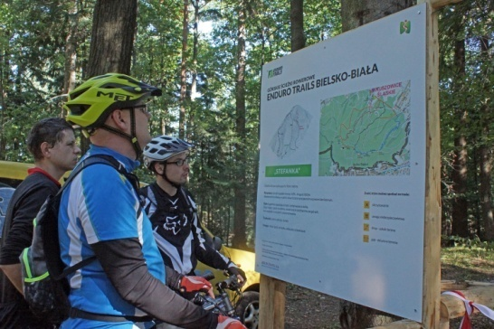
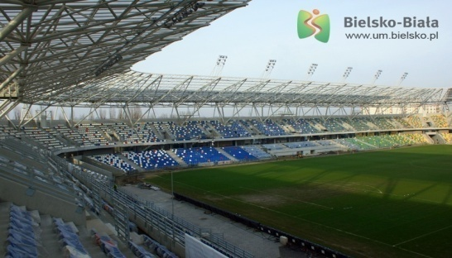
The most important municipal investments
Improvement of the water-sewer management in districts of Bielsko-Biała (implementation : AQUA S.A., value of the investment : 101,9 mln PLN)
The construction of a Broadband Network in Bielsko-Biała (value of the investment: 33 mln PLN)
Enduro trails – construction of moutain bike paths (value of the investment: approx. 1,2 mln PLN)
Construction of the Municipal Stadium in Bielsko-Biala
(value of the investment: 135 mln PLN)

Slide 28
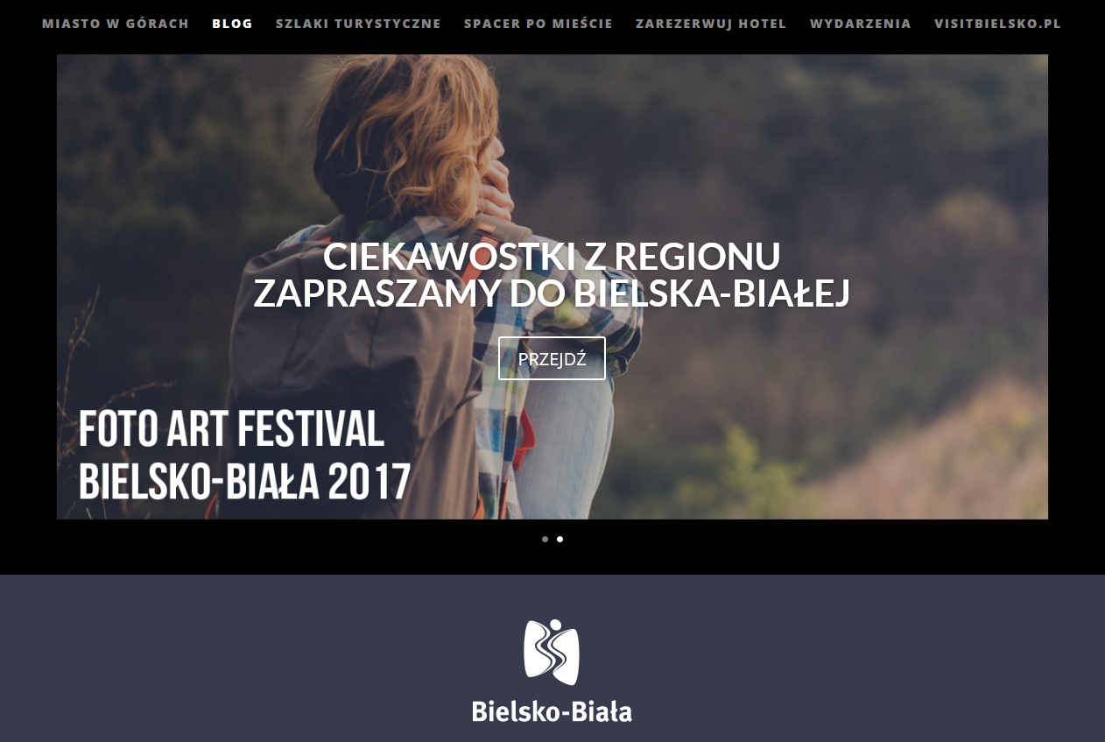
City promotion campaigns
Under the slogan "City in the Mountains", the City Hall of Bielsko-Biała carried out in years 2015-2017 a campaign aimed to strengthen the image of the city as an attractive tourist destination. The campaign was directed to people in age 25-50 from all over the country who are interested in tourism and travel. The city was promoted through advertisements on Facebook , also through banner campaign and blog posts describing the biggest attractions of the city and its surroundings.
www.miastowgorach.pl

Slide 29
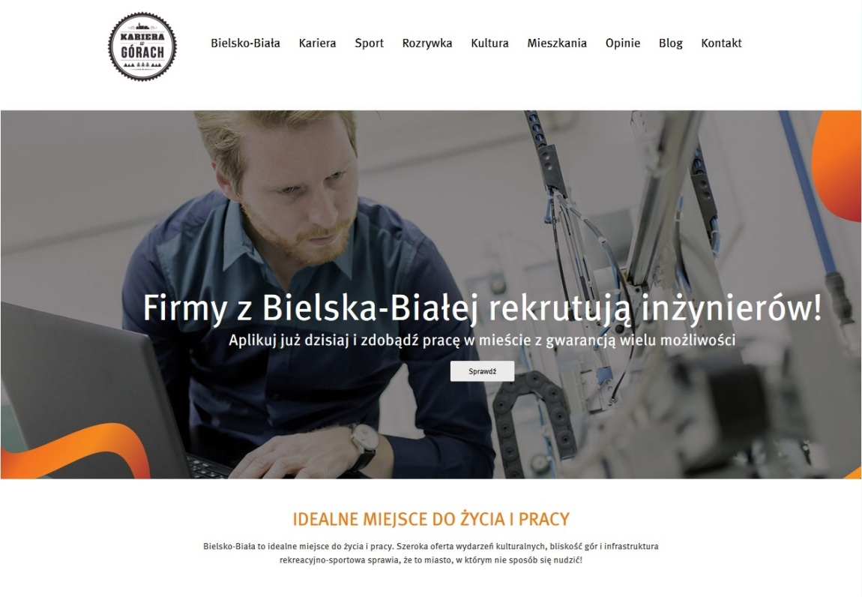
City promotion campaigns
The campaign "Career in the mountains" is an action initiated by the City Hall of Bielsko-Biała, which aim is to help local entrepreneurs recruiting qualified staff. Campaign concentrates on promoting Bielsko-Biała as an attractive place to live and start a professional career, in particular among young engineers who graduate technical universities. Currently 29 companies from Bielsko-Biała, which are struggling with staff shortages, joined the campaign and have offered employment to people with technical or IT education.
www.karierawgorach.pl

Slide 30
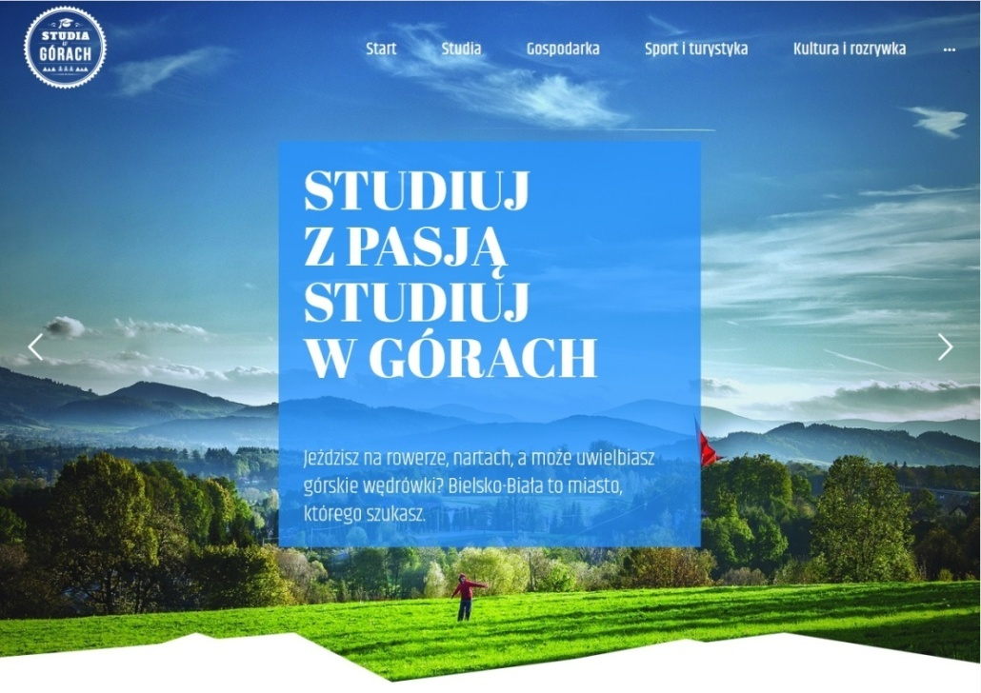
City promotion campaigns
"Studies in the mountains" is a joint campaign of the City Hall of Bielsko-Biała and the University of Bielsko-Biała aimed at promoting the benefits of studying, living and creating a professional career in Bielsko-Biała among future students. The campaign draws the attention of young people who face the dilemma of choosing their future university, that studies in Bielsko-Biała creates a great opportunity to combine the chance of getting a solid education with a chance to find a job during the studies. The campaign also indicates the attractiveness of Bielsko-Biała. The proximity of recreational areas encourage to be active at any time of the year. What’s more the numerous cultural and outdoor events are another big advantages that should attract young people to Bielsko-Biała.
www.studiawgorach.pl

Slide 31
Rankings 2019
Ranking | Category | Place in ranking
FORBES - Business – friendly cities | Cities between 150 thousand to 299 thousand inhabitants | 4
WSPÓLNOTA – Wealth of local governments – revenue ranking of cities 2018 | Cities with county rights | 12
FORBES – The Most Innovative Cities 2019 | Overall classification | 9
Polish Cities of the Future 2019/20 | Medium–sized cities – Business–friendly | 4
Polish Cities of the Future 2019/20 | Overall classification –Medium–sized cities | 5

Slide 32
City Hall of Bielsko-Biała
Strategy and Economic Development Department
pl. Ratuszowy 1
43-300 Bielsko-Biała
phone: + 48 33 4971 486
e-mail: wrg@um.bielsko.pl
www.um.bielsko.pl

